Slide 1
Introduction to Programming Using Python

Slide 2
Instructor – Ray Smith raysmith@alum.mit.edu
Many years of Programming – engineering, scientific, financial
Commercial, Scientific, Systems Languages – C, C++, Perl, Java, Python, Assembly
NEW Areas - Games for young 3-8 years
Notes:
What would you like to know about me?

Slide 3
Objectives
Programming for non-programmers
Demonstrate Operations and Methods
Enable and energize new programmers
Learning by DOING
Notes:
What do you want from this course?
What do you want from programming?

Slide 4
Our Online Class – Using Zoom
If any background noise, please mute – minimizes cumulative noise
Disable own video – too many reduces clarity
Can question via Chat – can be to ALL
Expecting Response: Start "QUESTION:"
Notes:
What do you want from this course?
What do you want from programming?

Slide 5
Session Progression – Each Week
Lecture and practice: 1.5 Hours
Follow-up Questions: .5 Hours
Similar to Programming – This Course
Skips, Repeats / Revisits
Student Guideline:
If you know it – Have Patience
If confused / unsure – ASK QUESTIONS

Slide 6
Programming Telling the Computer What to Do
The language, PYTHON, is a way
Popular, Powerful, and EASY
Like most human languages
You don’t have to know it all to do a lot
Notes:
What should the computer do for you?
What should the programming language (Python) do?

Slide 7
Course Outline (An Estimate)
Course Introduction – Up to here Slide 1
A Very Brief look at Python Language, Programming Environment Slide 10
Course Project – Start Slide 23
First Homework / Introduction Review Slide 29
A General Look at Programming Slide 34
More on Python /Review Slide 41
Notes:
What should the computer do for you?
What should the programming language (Python) do?

Slide 8
Course Outline - continued
More Review of Python Slide 46
Some Programming Exercises Slide 58
Printing, Formatting, … Slide 61
Testing, Loops, … Slide 64
More on program development … Iteration… Slide 70
Functions Slide 83
Notes:
What should the computer do for you?
What should the programming language (Python) do?

Slide 9
Course Outline - continued
Functions – friends… an example Slide 95
Strings Slide 101
Dictionaries Slide 105
Files Slide 106
More Stuff…If possible…
Notes:
What should the computer do for you?
What should the programming language (Python) do?

Slide 10
Learn by DOING
Using Python's built in tool IDLE
Integrated Development and Learning Environment
Interactive execution of Python parts
Python Program editor and execution
Lots of documentation, examples, help
Notes:
Who hasn't downloaded python (from www.python.org)?

Slide 11
Blazing Introduction to Parts of Python
Run Python IDLE
Follow along with instructor
– copy, experiment, question
>>> 1 + 1
2
Notes:
Make shortcut?

Slide 12
Blazing Introduction – continued IDLE primer
>>>: IDLE shell prompt (to you the user)
# : start of comment to be ignored
Otherwise: printout from IDLE
>>> 1 + 1 # Comment on 1 + 1
Notes:
Offline self-guide file: exercises/python_introduction.txt

Slide 13
Blazing Introduction Part 1 – Did we mention...
# Beginning comments
1+1, *, /, -, %, **, //, 1+2;3+4, 2+3*4,(2+3)*4
"a", 'b', """c""", '''d''',
"Ray" + " " + "Smith"
print(1, "one", 2, "two")
var_name = 1, a, b
NOT 1a, a b

Slide 14
Blazing Introduction Part 1B – Did we mention...
SyntaxError: cannot assign to literal
NameError: name 'a' is not defined
Traceback (most recent call last):
File "<pyshell#7>", line 1, in <module>
a
Python tries to be helpful
Can't always guess
Tries to be exact

Slide 15
IDLE – Changed my mind.
Edit a line by "up arrow" to line, then press ENTER, then make changes
ALT-P(Cth-P on MAC) will "open" last command for changes
After changing code, press ENTER to execute changed command (twice if part of a compound statement)

Slide 16
Blazing Introduction Part 2 Python Code Files
Create file File ➔ New File (my_work.py)
… add text (#my_work.py)
File ➔ Save
Maybe in folder “class_work” ???
Reuse - File ➔ Save As ➔ …new name

Slide 17
Blazing Introduction Part 2 - continued Hello World! - You Try!
Write simple program (hello_world.py):
print("Hello World!")
print("My name is your name.")
Save file – File ➔ Save
OR File->Save As…
Run program – Run ➔ Run Module
Notes:
Howabout: File→File-->Recent Files (select my_work.py)
Then: File→Save As… (hello_world.py)

Slide 18
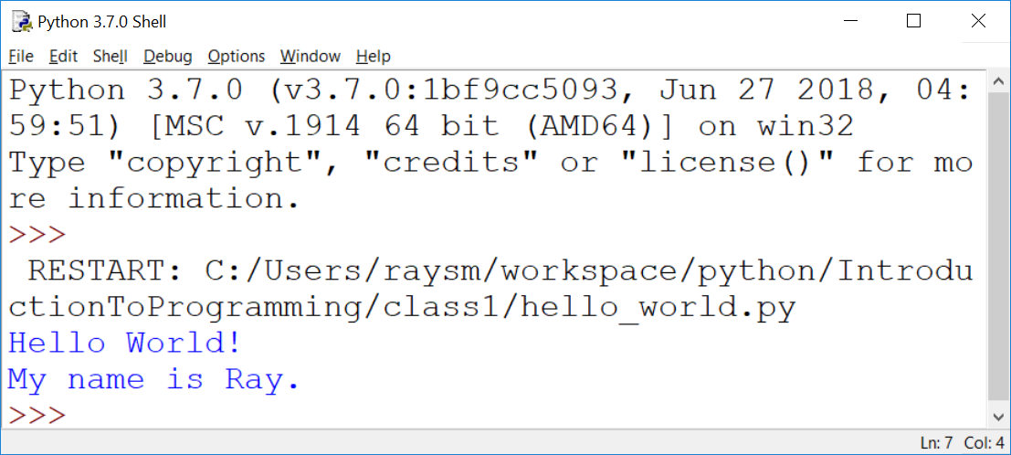
Hello World! – output – my example

Slide 19
Blazing Introduction Part 2 - continued Make a New Program – goodbye_world.py
"Goodbye World…"
Start with program closest to our goal
HINT: hello_world.py (File→Recent Files)
Save As… to new name BEFORE changing
Make changes creating new program
Run new program – Run ➔ Run Module
Notes:
How about goodbye_world.py ?

Slide 20
Blazing Introduction Part 3 – Did we mention...
What so far?
Chat it! Arithmetic… Error Messages
if, else, elif, True, False,
a == b, a != b, a > b, a < b, a >= b
while, for, break, continue, range()
input(), int()

Slide 21
Blazing Introduction Part 4 – Adding lists...
list1 = [1,2]
print(list1)
list1.append(4)
print(list1)
for mem in list1:
print(mem)

Slide 22
Blazing Introduction Part 4 – Adding Dictionaries...
d1 = {'name1':1, 'n2':2}
print(d1)
d1['n1b'] = "1a"
print(d1)
for nm in d1:
print(nm, d1[nm])

Slide 23
Course Project A Real Life Program YOU Will Create: Twenty Questions
… I’m thinking of a number …
Your program picks a number
Player guesses
Program tells if higher/lower
Program offers to play again
Notes:
What sort of programs are there? Could there be?
Calculators – financial, industrial
Games

Slide 24
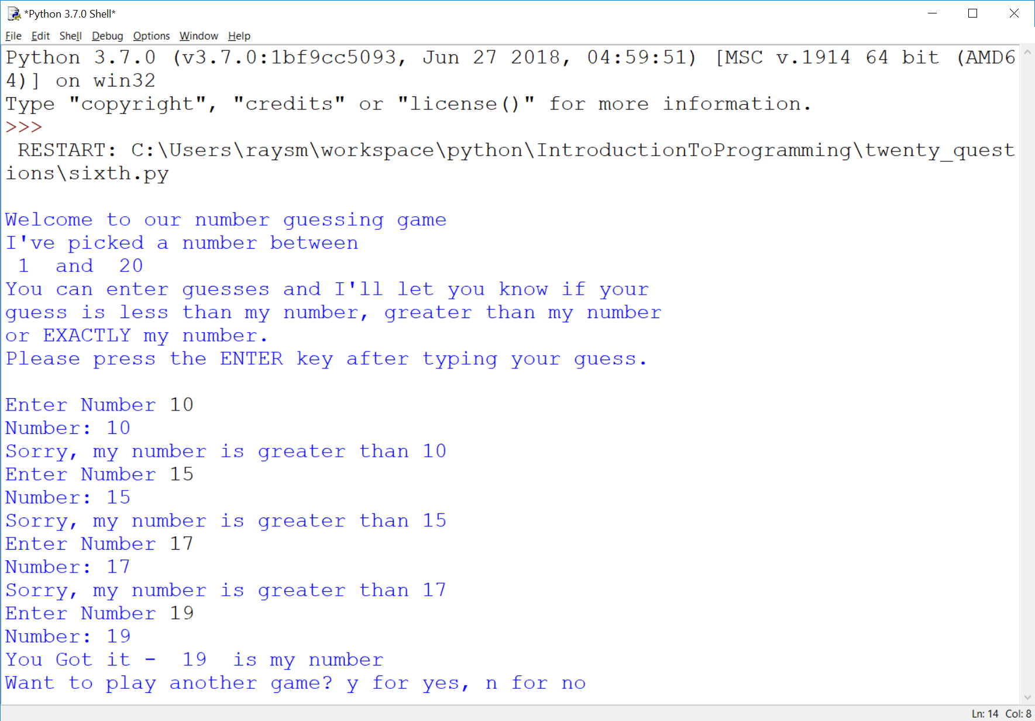
Here’s an example running
Notes:
What should we be able to do with programs?

Slide 25
Twenty Questions - continued
Programing → Iteration - improve along the way
Simplification also helps the user
Notes:
What sort of programs are there? Could there be?
Calculators – financial, industrial
Games

Slide 26
Guessing Game – Iteration 1
Create new file named “first.py”
Do the smallest part
Loop, asking number
Print number entered
Notes:
What is iteration?
Why iteration?
Any problems with iteration?
What's in a game?
goals
interaction
input
output
beginning, middle, end

Slide 27
Guessing Game – Iteration 1 - continued
Hints:
Place comments describing task
Use while True:
What variables?
Use string = input("…")

Slide 28
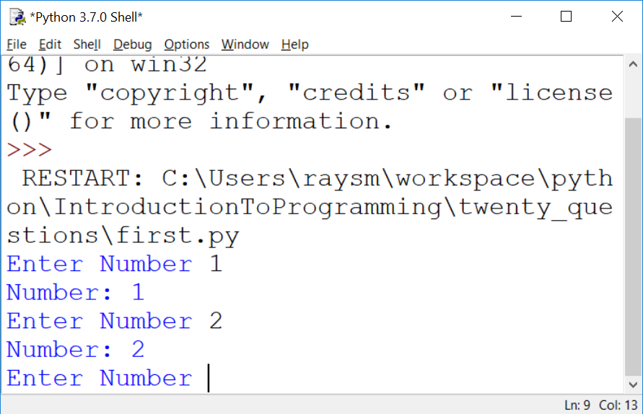
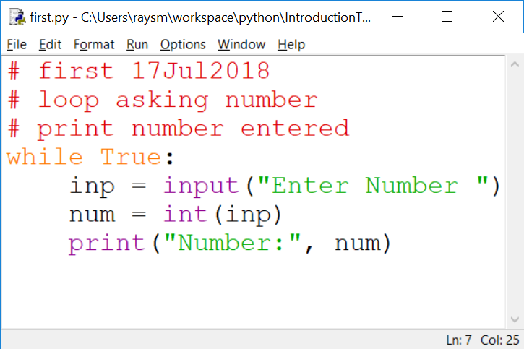
The First Iteration
Notes:
What do we get from doing this iteration?
learning
testing
early fun?
What does it cost us?

Slide 29
HOMEWORK / Review:
exercises/introduction/python_introduction.txt
Repeat each example from file
Try a couple of your own making
Don't worry about mistakes!
OPTIONAL: Four 4s – contest – mail-in
Second iteration (second.py)
Notes:
First few lines are just information about this version of IDLE.
Plus, you can always type "help".

Slide 30
A Quick Introduction to Python with a wordy offline guide file - IDLE
A file with some beginning examples
open python_introduction.txt
File → Open →… exercises → python_introduction.txt

Slide 31
HOMEWORK / Review - continued: python_introduction.txt
Python 3.7.4 (tags/v3.7.4:e09359112e, Jul 8 2019, 20:34:20) [MSC v.1916 64 bit (AMD64)] on win32
Type "help", "copyright", "credits" or "license()" for more information.
>>> # The following is an interactive introduction to basic Python concepts.
>>> # The text is pretty much as I typed it in to the Python IDLE shell,
>>> # and got printed out by the shell python shell evaluation.
Notes:
First few lines are just information about this version of IDLE.
Plus, you can always type "help".

Slide 32
Python_introduction.txt…continued
>>> # You might get some useful practice by trying these examples on your
>>> # computer in the IDLE shell.
>>> # Lines with # are ignored by python from the # character to line end.
>>> # This introduction takes place within the python IDLE interpreter
Notes:
Repetition because some folks just use this file.
File was created while running IDLE and learning!

Slide 33
Python_introduction.txt…continued
>>> # Lines starting with ">>> " can be directly typed, minus the ">>> ",
>>> # into IDLE
>>> # Text typed after the ">>> " is evaluated by python, and the value,
>>> # if any, is displayed.
>>> 1
1
>>> 1 + 2
3
Notes:
You may want to refer to this later for review.

Slide 34
Programming Ideas
What is programming
Like
Not like
Programming Tools
Creating, Running
Improving through – copy, iteration

Slide 35
Fundamental Programming Concepts – Computer == VERY Obedient Servant
Car Example
Most cars are alike
Does what you tell it – hopefully what you want
Same response every time – almost – e.g. forward / backward
Troubles - Car gets the blame…
Notes:
What does a car do for you?
What does a car do that you don't really need / want?
What is the most difficult thing about using a new car?

Slide 36
Activities – Similar to Programming
Abstract / Indirect
Cooking recipes
Travel directions
Assembly instructions
Physical – What you see is what you get
Construction - Roads, Buildings
Notes:
What's difficult about using recipes, maps, instructions?

Slide 37
Like Computer Programming, They do / have
Build once – use many times
Builder and user(s) often different
Building errors show up many times
Mistakes don't always show up immediately

Slide 38
Unlike Computer Programming, they have / are
Physical materials
Hard to copy
Hard to manipulate
Easy to see

Slide 39
What's Easy to Programming – No so physical
Creation / copying / moving is a snap
Don't wear out
Change easy
Work on new, while using old
Notes:
What makes programming easy/easier than work in the "physical" workplace?

Slide 40
What's Not Easy – because No so physical
Can't "see" it
Everything connected – unexpected consequences
Not easy to tell how close to done
Notes:
What is not so easy in programming?

Slide 41
Python Rules and Mechanics - You will see more Python Details…
What is Python – A Programming Language
Comments
Values – Integer, Float, String
Variables – contain values
Computation / Arithmetic
Rules / Style

Slide 42
Still more Python Tools…
Decisions – if, else
Looping – while, for, break, continue
Grouping – indentation, functions, classes
Functions – parameters, returning
Data Structures – lists, dictionaries

Slide 43
Our Sandbox – IDLE Demonstration and Testing
https://www.python.org
Download latest python example: 3.7.0
Python shell
Documentation
IDE - editor, execution, debugger
Notes:
What would you like from a programming tool / helper?
IDLE can provide the environment for us to directly use Python to do things.
What's necessary?

Slide 44
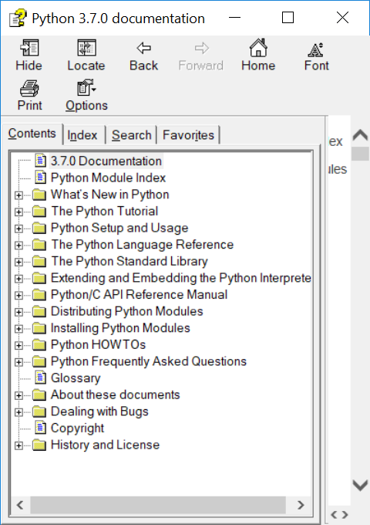
Documentation – Lots of Nice STUFF

Slide 45
IDLE – continued
Python Documentation:
Help ➔ Python Docs
Help on IDLE:
Help ➔ IDLE Help
Python Program Examples:
Help ➔ Turtle Demo
Notes:
What should IDLE do for you?

Slide 46
A Second View
Programming Calisthenics
5 minutes - Using IDLE
Do One Example of EVERYTING you have seen
Don't worry about mistakes, errors – that's what IDLE is there for, errors are SOMETHING too
Done Early – Do Two Examples
E.g. 1+2, a=5, a**3, if a == 5

Slide 47
A Quick Review of Python
What is
>>>
# stuff here
1
1 + 2

Slide 48
A Quick Review of Python - continued
What is
A string
"here we are"
'there we go'
"It's the way"

Slide 49
A Quick Review of Python - continued
What is
"""
More and
More
"""

Slide 50
A Quick Review of Python - continue
What is
4;5;6
2+3,2*3

Slide 51
A Quick Review of Python - continued
How do we print a value?
On an IDLE line?
Using "print"

Slide 52
A Quick Review of Python - continued
How do we print:
"Hello World!"?
The sum of 1 plus 2?
Three strings "a", "bc", "def"?

Slide 53
A Quick Review of Python - continued
What is a variable?
Of what good is a variable?
Rules for naming a variable?
How do we:
Set up a variable?
Use a variable?

Slide 54
A Quick Review of Python - continued
What does this do:
first = "who"
print(first, "is on first")

Slide 55
A Quick Review of Python - continued
Legal variable names? Why?
a
tom
max_val
A21
target_hi __file__

Slide 56
A Quick Review Python - continued
Illegal variable names? Why?
1a
my name
short-stop
high.val

Slide 57
A Quick Review of Python - continued
What are some program flows?
What are some decisions to be made in program flow?
What are some Python decision making keywords?
How is each decision keyword used?

Slide 58
A Quick Review of Python - continued
Write a test that prints "a" if a is greater than b. Do we need something first?
Write a test that prints "a" if a is greater than b and "b" if not. Do we need something first?
Notes:
Variables need initialization before they may be used.

Slide 59
A Quick Review of Python - continued
Program Exercises
Write a loop that prints the numbers from 1 to 10.
Write a loop that prints the odd numbers from 1 to 9.
Notes:
Variables need initialization before they may be used.

Slide 60
Python Language - continued
Arithmetic almost like algebra class : +,-,*, >, >=, ==
BUT single “=” is for assignment
max_value = 20
value = value + 5
in = pr * (1+rate)**years

Slide 61
Python Language – print function
Prints one or more values
Separate values by commas (,)
print("Hello")
print("value: ", 10)
print("Maximum: ", max)

Slide 62
Python Language – print function - more
Inserting variables/values –
Formatted string (f-strings)
v_str = "string value"
v_int = 123
print(f"this has v_str={v_str}") print(f"this has v_int={v_int}")

Slide 63
Python Language – formatted string in action
>>> v_str = "string value"
>>> v_int = 123
>>> print(f"this has v_str={v_str}")
this has v_str=string value
>>> print(f"this has v_int={v_int}")
this has v_int=123
>>>

Slide 64
Python Language - Testing
“if” condition “:”
One or more indented lines
if value > max_value:
print("value", value, " is big")
print("Try less than", max_value)

Slide 65
Python Language - Looping
“while” condition “:”
One or more statements indented
to the SAME indentation
while value < max_value:
print("value ", value, " is OK")
value = value + 10
print("value is now", value)
Notes:
Why loops?
What should a loop have / do?

Slide 66
Exercise: “Times Tables” for 13 – 1x13, 2x13, …,13x13
Hints:
Create new file named “timestable.py”
Setup: name and set variables – nval = 13 first =1 last = nval n = first
Loop: while n <= last:
print(n, "x", nval, "=", n * nval)

Slide 67
Python Language – input function
Get user input
inp = input()
Prompt user first
inp = input("Please enter:")
Convert to Integer
nval = int(inp)
Notes:
Accepting input and dealing with it makes programs much more powerful than calculators or Television.

Slide 68
Exercise: “Times Tables” – with user giving number
Hints:
Use “timestable.py” as start
New file name = “timestableN.py”
Replace “13” with variable “nval”
Use inp = input("Enter mult:")
Use nval = int(inp)
Notes:
Why a NEW file name?
When do we create it?
WHY?

Slide 69
Exercise for LATER: “Times Tables” – Full table from 1x1 to NxN
Hints:
timestableN.py → timestableNbyN.py
How to do it by hand?
How many loops?
What are the variables?
Notes:
What are the issues?
What's the most difficult thing to achieve.

Slide 70
Second Iteration – A bit More
Set target value
Quit if number entered number equals target
Hints:
Start from first.py
Use break to quit while loop
Notes:
Why use File→Save As ("second.py") BEFORE any changes or additions?
HINT: What happens if, after one does a lot of additions, one does File→Save ?
What happens to the original "first.py" file contents?

Slide 71
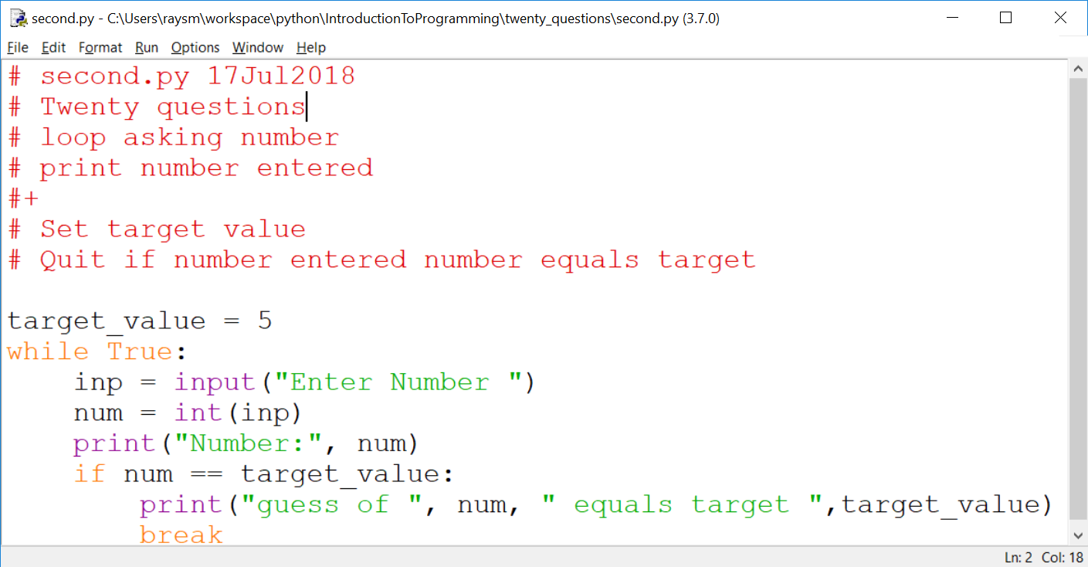
Second Iteration – continued

Slide 72
Thinking of Iterations
Think Features
Prioritize
Order most to least / easy to hard
Build to the next
Balance Big Bang! with Show it Now!
Show progress
Notes:
What is(are) the simplest idea(s)
Before anything else what does the program do?
What's the next?

Slide 73
Sample Program Iterations
First:
loop asking number
print number entered
Second:
Set target value
Quit if number entered number equals target

Slide 74
Think of the Iterations - continued
Third: Say if greater, less or equal
Fourth: Set target to random number
Fifth: Say goals, rules before start, including "a number between…"
Sixth: Ask player if they want another game – play multiple times
Seventh: Handle typos / illegal numbers

Slide 75
More Python – Variables Places to store values
Holds data, with a name
Eases the use/reuse our data/results
Names have rules:
Start with a letter (a-zA-Z_)
Followed by zero or more digits (0-9) or letters
OK - a, a1, my_variable, a2or3
NOT - 1, 1a, my-variable, "ray,smith"
Notes:
Why variables?
What are the issues with variables?

Slide 76
Python Language Guidelines with some exceptions
A statement is on ONE line
YES:
sum = 1 + 2
NO:
sum = 1 +
2
Parenthesized grouping may be on multiple lines
YES: sum = (1
+ 2)
Notes:
Note any place that has parentheses allows multi-line / indentation free formatting. Examples: arithmetic (….), print(….), and other functions.

Slide 77
Python Language Guidelines - continued
A group of statements:
Are executed in order
Must start at same indentation (from left)
BUT Parenthesized grouping may have any indentation within the parentheses
Notes:
Don't mix spaces and tabs
Stick with spaces
Editor can help

Slide 78
Python Language Guidelines - continued
YES:
start = 1
last = 3
increment = 1
NO:
start = 1
last = 3
increment = 1

Slide 79
Python import Bring in support
Importing brings in support
import random # for random numbers
from random import randint # just named
Examples will often include import statements
Notes:
Where do we find examples?
Internet
Documentation
Tutorials

Slide 80
Help is a click away Web searching
Try "python thingies …"
E.g. python random int between two numbers
Found: python - Generate random integers between 0 and 9 - Stack Overflow
GOT:
Try:
from random import randint
print(randint(0, 9))

Slide 81
Help is a click away Web searching - continued
Be brief – search algorithms are pretty good
First code may be wrong.
Someone saying Did this … didn't work
Stackoverflow.com
Question…
Answer…
Checkmark – Best liked answer
Answer…
Notes:
Internet is like a bunch of varied friends
Often correct but sometimes on a different track

Slide 82
Friends – Simple List Example / Exercise
list_friends.py – just print a list of friend names
my_friends = ["ray", "sue", "joe"]
for name in my_friends:
print(name)
Notes:
Use the previous iteration as a start to the next.
I'll go around and watch.
Raise had if a question.

Slide 83
Friends – Simple List continued
add_friends.py – add new friends
while True:
ans = input("Enter friend:")
if ans == "":
# put list code here
else:
my_friends.append(ans)
Notes:
Use the previous iteration as a start to the next.
I'll go around and watch.
Raise had if a question.

Slide 84
Functions – Divide and Conquer
Hide the particulars
Delay consideration
Parts of the problem placed in functions

Slide 85
Functions – continued
Called (invoked/started) with name(comma-separated list of parameter values)
Returns result of operation
top = max(1,2,3)

Slide 86
Functions – continued
Function Definition – what it is going to do
Name – same style/restrictions as variable name
Parameters – data which is passed to the function
Comma-separated list

Slide 87
Functions – continued
Body – Where the actions are
Regular code
Uses data passed in parameters by parameter names

Slide 88
Functions – continued
def add2(value1, value2):
sum = value1 + value2
return sum
sum1 = add2(1,2) # sum1 gets 1+2
sum2 = add2(3,4) # sum2 gets 3+4
Notes:
Function Calling / Invocation
How do we call the function?
Called with the function name
Including parenthesized list of values
The values are passed to the function

Slide 89
Functions – Simple Example / Exercise Extend add_friends, writing a function
add_friends_fun.py - from add_friends.py
def print_friends():
global my_friends
# code to print list
…
if ans == "":
print_friends() # Execute function
Notes:
Use the previous iteration as a start to the next.
I'll go around and watch.
Raise had if a question.

Slide 90
Functions – continued Exercise – Special Product Function
product.py
Write a function product(factor1, factor2, factor3)
Returns the product of the values factor1, factor2, factor3.
Test it on the following:
.5, .4, .3; 1, 2, 3; -1, -1, -1;
Notes:
Function Calling / Invocation
How do we call the function?
Called with the function name
Including parenthesized list of values
The values are passed to the function

Slide 91
Functions – Keyword parameters
Optional – for seldom used
Any Order – avoids ordering confusion
Parameter names help understanding
myfun(key1=2, key2=7)
myfun(key1=4) # default - key2
myfun() # All defaulting
Notes:
Missing or misplaced function arguments are a big problem

Slide 92
Functions – Keyword parameters - continued
def myfun(key1=None, key2=7):
if key1 is None:
key1 = 5 # key1 not present
return key1 + key2
Notes:
What are the benefits of using None vs explicit value?
None is used to definitely indicate no value was supplied.
In this case – the call was made without the keyword parameter.

Slide 93
Functions – Keyword parameters – example – built-in function: print()
def print(*args, end="\n", sep=" ")
print("a", "b", sep=":") #different sep
Print("c","d", end="") #No end line
Exercise: Try using each print keyword

Slide 94
Functions – Keyword parameters – print() Exercise 2: – Print factors – factors.py
Prompt user for n
For numbers 1 to n, print factors
1: 1
2: 1,2 - factors on same line
3: 1, 3
4: 1,2,4
5: 1,5
6: 1,2,3,6

Slide 95
Functions – Keyword parameters – print Exercise
Improvements:
Omit 1, and number itself as factors
Only print numbers with at least one factor other than 1 or itself
Extra: Use "for" loop

Slide 96
Lists – a review - numbered / expandable
Named group of values
friends = ["tom", "dick", "jane"]
Access by position, starting at 0
print("1st, 3d:", friends[0], friends[2])
Add to end
friends.append("joe")
Notes:
First element at index: 0
Last element at index: len()-1
What sort of information would fit into a list?

Slide 97
Functions – An example of use friends_family/friends_1.py
Assume a database or game or organization which includes friends
Needs utilities / worker functions
Add friends, list friends, check if one is a friend, …
Build up – friends_family/ friends_1.py, …

Slide 98
Functions – friends_1.py
First start
A function to list friends
A function to add a friend
A "test" to help verify our work

Slide 99
Functions – friends_2.py
Improving – adding to friends_1.py
add_friends – multiple friends
test_add_friends – test new functionality

Slide 100
Functions – friends_3.py
Improving
is_friend – checking if friend
test_is_friend – test new functionality

Slide 101
Functions – friends_mod.py
Facilitate built-in test
if __name__ == "__main__":
print("Self test", __file__)
test_add_one_friend()
test_add_friends()
test_is_friend()

Slide 102
Functions – friends_4.py
Code in friends_mod.py, facilitating reuse
from friends_mod import *

Slide 103
Strings - Like a lists of characters - ALMOST
Assigned as a group, not via index
str_name = "abcdef"
NOT str_name[0] = "a"
Can be Accessed by index
if str_name[1] == "b":
print("Yep it’s the second character")
Notes:
What sort of information would fit into a string?

Slide 104
Strings - continued
Strings can't be changed in place (immutable)
But += works
name += last_name
Because x += y defined as x = x + y
name = name + last_name
Notes:
Not modifiable == immutable
Don't change – replace - a = (do stuff with a or parts of a)

Slide 105
Strings – continued - immutable
Not modifiable == immutable
Don't change – replace
str_name = "a" + str_name[1:]
Notes:
Not modifiable == immutable
Don't change – replace - a = (do stuff with a or parts of a)

Slide 106
Dictionary - Group of values - Access by name
trades_d = {
"painter" : "tom",
"landscaper" : "joe",
"plumber" : "kate"
}
print("landscaper:", trades_d["landscaper"])
Notes:
What sort of information would fit into a dictionary?

Slide 107
Dictionary - continued
for trade in trades_d:
print(trade, trades_d[trade])
for tra, who in trades_d.items():
print(tra, who)
trades_d["programmer"] = "ray"
if "painter" in trades_d:
print("We have a painter")
Notes:
.

Slide 108
Files Data that stays around
Stream of bytes/characters "on disk"
Has a File Name
Open File – Create, if new
Read / Write sequentially
Close File
Notes:
File, as a named group of bytes is an abstraction.
Years ago the programmer needed to understand more about the structure.
Your Python program is a data file to some program(s).

Slide 109
Files – continued – Creating
Be careful with names- don't overwrite
#create_file.py
with open("my.txt", "a") as fout:
for i in range(1,5):
print("line %d" % i, file=fout)
Notes:
Open modes "r" –read, "w" – write, "a" - append

Slide 110
Files - continued
# read_file.py
file_name = "my.txt"
with open(file_name) as finp:
for line in finp:
print(line, end="")
Notes:
Note: print adds a newline at the end by default.
To avoid this, use the end="" parameter to replace the default newline with "".
e.g.

Slide 111
Files – continued – Exercises
Create your own two examples
1. create_file.py - Write and check
Save as read_file.py
2. read_file.py – Modify to do reading…
Notes:
What are the benefits of save / modify approach?
What are the pitfalls?

Slide 112
Files – continued Notes - A Simple Data Base
Goal:
Access to my data by name
Plan:
Save data in a text file
Search all lines for patterns e.g. name
Print lines where found

Slide 113
Notes - A Simple Data Base – Continued Details
Create two test files
test.notes – real short just a couple of lines
Joe Name Joe Smith
Joe Address 100 Main
Sam Name Sam Jones
Sam Address 20 Center
Watertown.notes – longer with more varied data

Slide 114
Notes - A Simple Data Base – Continued Details
Make "notes.py" program file.
Will display lines from a text file
that contain a given text string.

Slide 115
Notes - A Simple Data Base – Continued Iterations
1. Read specific file e.g. "test.notes"
print out all lines
2. Print only lines containing "student"
How to match lines ?
2.a Match (Student, STUDENT)
3. Prompt for, then accept file name, pattern
4. [Extra Credit] Multiple text patterns

Slide 116
Classes – Structure – Object Oriented
Organize data like functions organize procedure
Can hold data as well a functions
Provides software a method for simulating complex objects found in nature e.g. people, processes

Slide 117
Classes – Programmer Defined Patterns for Objects to be used
Complex data types
Person: name, home_address, work_address
Address: number, street, state
Complex Activity /Organization
AirPort: name, address, runways
Runway: length, width, location, direction
Notes:
Can you provide examples:
Data types
Activity/Organization

Slide 118
Classes – In action
Setup instance object:
obj = ClassName(values…)
Use of created object:
obj.list() # list object
obj.add(obj2) # add obj2 to object

Slide 119
Classes – definition
Definition:
class Person:
def __init__(self,
name,
is_friend=False,
is_family=False,
address=None):
… setup person …

Slide 120
Classes – continued
Definition - Class functions:
__init__(self,…) - initialize data
__str__(self,…) - used show as string
Other functions(self,…) – members that do object's actions

Slide 121
Classes – continued
Use - Class functions:
obj = ClassName(…,values) calls __init__ to initialize obj state / data
print(obj) calls __str__ - shows obj as string
obj.member_function(…,values) – does actions on/with obj object

Slide 122
Classes – Example: Person, PersonGroup Generalizing previously mentioned friends_family
Person, in file person.py, Class Person
Person's information
Person's setup / initialization
Person's actions

Slide 123
Classes – continued
Class PersonGroup, in file person_group.py
Group's information
Group's setup / initialization
Group's actions e.g. list, add, test for membership

Slide 124
Future – Python as "Glue"
Python can run other programs
E.g. notepad.exe
import subprocess as sp
fname = "notes.py"
sp.Popen(["notepad.exe", fname])

Slide 125
F-string – easer / more powerful string formatting
building print strings
Put "f" before first quote
Place variable inside "{}"
t_nm = "Tom"
m_nm = "Mary"
print(f"tom={t_nm} mary={m_nm}")
Notes:
.

Slide 126
F-string – continued
{variable/expression:formatting}
:5d – integer 5 places
:5.2 – float 5 places, 2 dec pt
:>5 – string 5 places right justified
Notes:
.

Slide 127
F-string – continued
runners = { "tom" : { "count" : 5,
"time" : 3.8
},
"joe" : { "count" : 7,
"time" : 5.728
},
"mary" : { "count" : 10,
"time" : 7.62
}
}
Notes:
.

Slide 128
F-string – continued
# Print Heading
print(f"{'name':10}"
+ f" {'count':5}{'time':>5}")
for rname in runners:
info = runners[rname]
print(f"{rname:10} {info['count']:5d}"
+ f" {info['time']:5.3f}")
Notes:
.

Slide 129
F-string – continued
Output:
name count time
tom 5 3.800
joe 7 5.728
mary 10 7.620
Notes:
.

Slide 130
Finding python.exe from IDLE
Python 3.7.0 (v3.7.0:1bf9cc5093, Jun 27 2018, 04:59:51) [MSC v.1914 64 bit (AMD64)] on win32
Type "copyright", "credits" or "license()" for more information.
>>> import sys
>>> print(sys.executable)
C:\Users\raysm\AppData\Local\Programs\Python\Python37\pythonw.exe
>>>

